Slide 1

Strategic Framework
and Institutional Presentation
Council of Chambers of Commerce of the Americas
(CCCAM)
2026 - 2030
Notes:
[Sources]
- Propuesta Estratégica Consolidada CCCAM 2026–2030, portada y alcance del documento.

Slide 2
EXECUTIVE SUMMARY AND MANDATE
A Hemispheric Platform to Coordinate and Deliver
CCCAM turns the collective capacity of the chamber system into a permanent platform for integration, cooperation, and execution at the service of businesses and territories.
Institutional Nature
A private, non-profit, non-governmental international association headquartered in Bogotá.
INSTITUTIONAL MANDATE
“Bring together the capabilities and best practices of chambers of commerce across the Americas through a permanent mechanism for integration and cooperation that recognizes the diversity of their realities and models, to continuously promote and defend the free enterprise system, build a unified continental voice, and turn shared challenges into high-impact hemispheric solutions, collaborative projects, and measurable results that strengthen competitiveness, create value for businesses, and contribute to the sustainable development of communities across the region.”
Hemispheric Scope
Brings together chambers from across the Americas under a continental vision that recognizes subregional diversity.
Collective Capacity
Turns the chamber network into a shared voice, knowledge, connections, and projects.
Complementarity
Connects and amplifies existing capabilities without replacing mandates or duplicating services.
Articulate Capabilities
Defense of Free Enterprise
Build a Unified Voice
Concrete Results

Slide 3

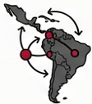
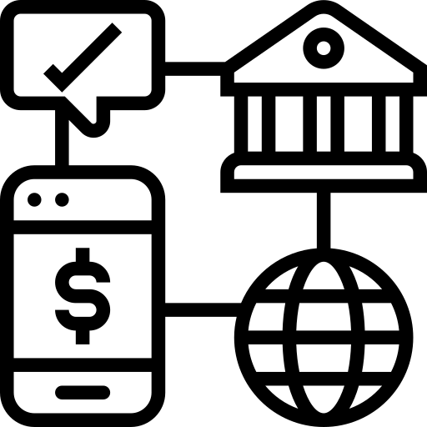

HEMISPHERIC STRATEGIC CONTEXT
Four Forces Demanding Hemispheric Articulation
1. AI Revolution
2. Supply Chain
Reconfiguration
AI-related commerce is growing at 40% (vs. 6.5% globally).
Latin America is emerging as an alternative value hub.
Imperative: Mandatory adoption of technology by chambers to stay relevant.
Imperative: Integrated regional matchmaking platforms.
3. Rise of Services
4. Geopolitical
Fragmentation
Services account for 27% of world trade, growing twice as fast as goods.
Record tariffs are diverting +USD 165,000M from the U.S.-China corridor.
Imperative: Regional leadership on the digital agenda.
Imperative: The Americas need a coordinated voice to capitalize on nearshoring.

Slide 4
VALUE PROPOSITION AND MEMBERSHIP
CCCAM Creates Value at a Hemispheric Scale
MEMBERSHIP:
CHAMBERS OF COMMERCE ONLY
01
Hemispheric Coverage
A continental platform present across the 5 subregions.
1
1
=
Chamber
02
Broad, Inclusive Representation
Recognizes the diversity of chamber models and territories.
vote
03
A Unified Business Voice
Common technical positions before strategic actors.
Exclusive Membership
Only legally established and recognized chambers.
04
High-Impact Opportunities
Trade, investment, knowledge, and partnerships with results.
Institutional Equality
Size, income, or contribution do not affect voting rights.
05
Institutional Complementarity
Strengthens capabilities without replacing mandates or services.
Partners
Engage through cooperation or projects, without governance rights.
Complement, not compete: CCCAM recognizes and connects the value of other existing organizations

Slide 5
INSTITUTIONAL TRAJECTORY
From articulation to an established organization
Between May and September 2026, CCCAM moved from collective design to a network with governance, an agenda, and execution capacity.
MAY – AUG 2026
22 SEP 2026
23 SEP 2026
24 SEP 2026 →
Design and
articulation
Launch and
Founding Act
First
General Assembly
Network
activation
Collective construction of the strategic framework, governance model, Statutes, and launch programs.
Public presentation and signing of the Constitutive Act by 36 chambers from 18 countries.
Election of the Presidency and Board of Directors, 2026–2027 Work Plan, fees, and leadership roles.
Tools for MSMEs, C2C meetings, networking, and engagement with business initiatives.
NEXT MILESTONES
Dec 2026
2026 - 2027
Jan to Mar 2027
2027
Oct 2027 (to be confirmed)
Designation of the Executive Director
Approval of Internal Regulations and Code of Ethics
First annual membership fee
CCCAM regional meetings
First CCCAM Summit

Slide 6
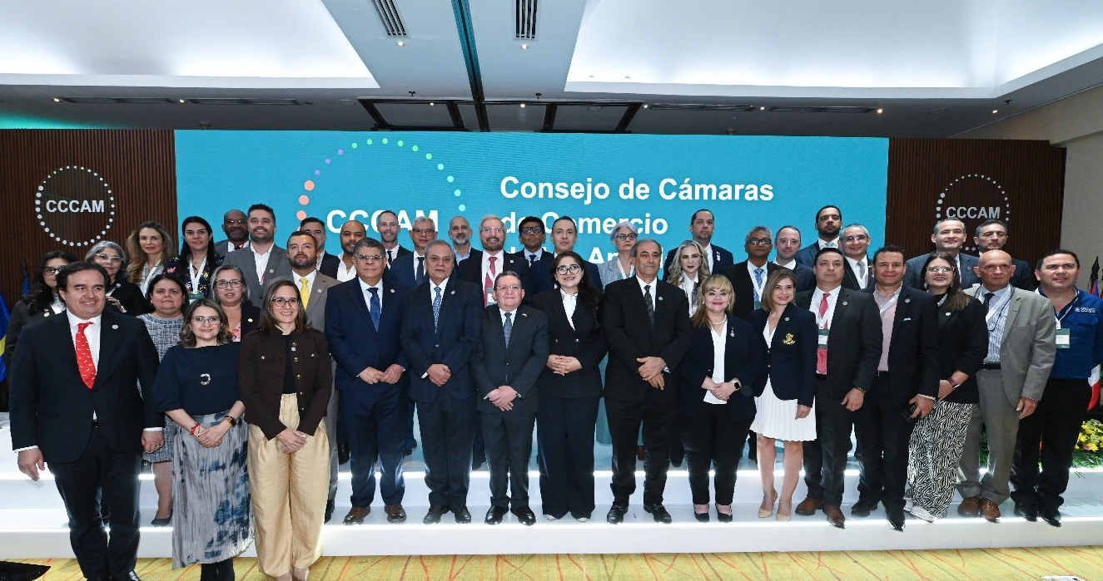
SEPTEMBER 22, 2026
Launch and Founding Act
Bogotá brought together chambers, governments, international organizations, and partners to formalize the birth of CCCAM.
36
18
5
founding chambers
countries
regions
Institutional support
El Salvador: Alberto Acosta, Undersecretary of Trade and Investment
Honduras: Carlos Flores, Second Principal Delegate of the Republic of Honduras, and Diana Baleska Herrera – Third Principal Delegate of the Republic of Honduras
Colombia: Manuel A. Naranjo, Vice Minister of Business Development – MinCIT
IDB Ramiro López-Ghio, Representative in Colombia
ICC John W.H. Denton AO, Secretary General

Slide 7
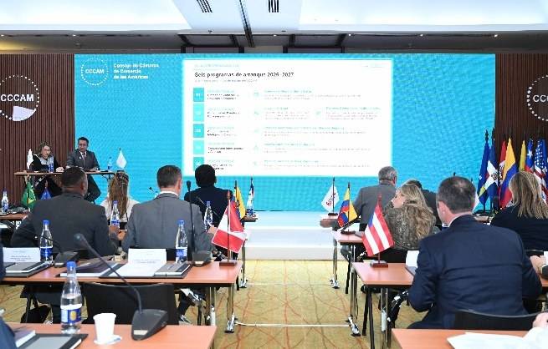
SEPTEMBER 23, 2026
First General Assembly: Governance Installed
The founding chambers elected their authorities and approved the first strategic and operational decisions.
1
Presidency
The Bogotá Chamber of Commerce was elected unanimously.
2
Board of Directors
Ten Regional Vice Presidencies: five elected by the chambers of each region and five adjuncts appointed by the Presidency.
3
2026–2027 Work Plan
Approved unanimously, with leads for each work stream and technical tables. A Women’s Empowerment work stream was proposed.
4
2027 Membership Fees
The fee scheme was approved unanimously and differentiated according to each chamber’s number of affiliates.
Quorum: 33 chambers with voting rights
Modality: hybrid, in person and virtual
Chair of the Assembly: Alex Zegarra, CNC Bolivia
Secretary: María Mónica Conde Barragán, CCB
5
Proposals
First CCCAM Summit in Bolivia (October 2027) and regional meetings in San Juan (Puerto Rico) and Cortés (Honduras).

Slide 8
ORGANIZATIONAL AND GOVERNANCE MODEL
Three differentiated bodies, one clear architecture
The Statutes separate sovereign guidance, strategic direction, and permanent execution.
1
2
3
General Assembly
Board of Directors
Executive Directorate
SOVEREIGN BODY
PERMANENT STRATEGIC GOVERNANCE
PERMANENT EXECUTIVE BODY
• Composed of all member chambers
• One chamber = one vote
• Approves Statutes, Strategic Plan, budget, and fees
• Elects the Presidency and, by region, the Elected Vice Presidents
• 11 members: Presidency + 5 Elected Vice Presidents + 5 Appointed
• Meets at least four times a year
• Approves positions, partnerships, and new members
• Appoints the Executive Directorate
• Technical and operational management
• Legal representation and resource management
• Execution of Board of Directors agreements
• Director selected through an international competitive process, for 4 years

Slide 9
ORGANIZATIONAL AND GOVERNANCE MODEL
BOARD OF DIRECTORS
Board of Directors
Composed of eleven (11) representatives from member chambers
1 President + 10 regional vicepresidents = 11 members
President
Elected Vice-Presidents
Appointed Vice-Presidents
5
Elected by the chambers of their region
5
Designated by the Council's Presidency
One member per region
One member per region
TERRITORIAL PRESENCE IN BOTH GROUPS
North America
Central America
Caribbean
Andean Region
Southern Cone
1
Notes:
[Sources]
- Artículo 22, Naturaleza y composición, imagen suministrada por el usuario.
- Propuesta Estratégica Consolidada CCCAM 2026–2030, numeral 4.4, para la denominación de las cinco subregiones.
- Sistema visual heredado de Presentacion_General_CCCAM_2026_2030_Actualizada.pptx y del Manual de Marca CCCAM.

Slide 10


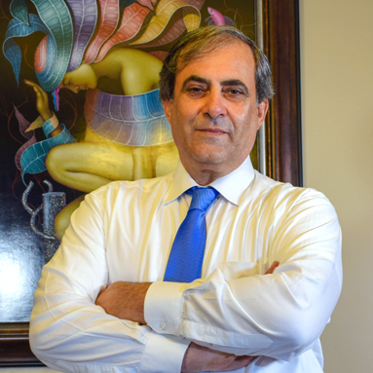

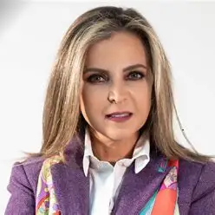
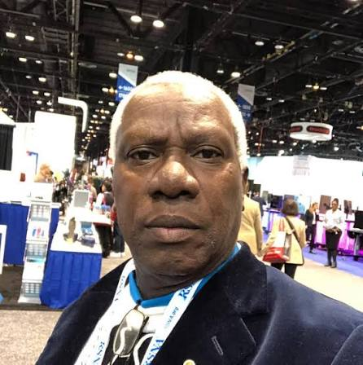
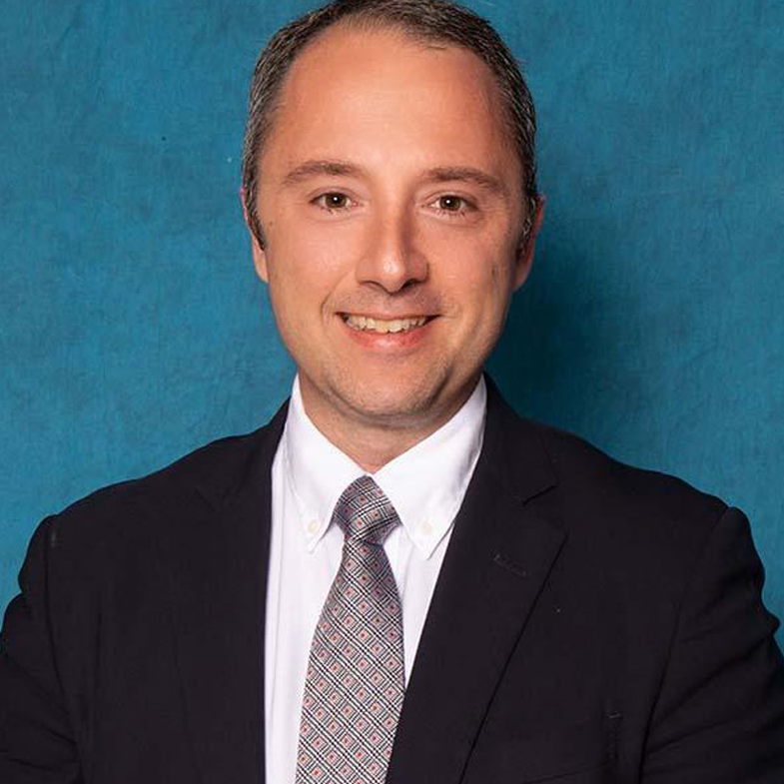
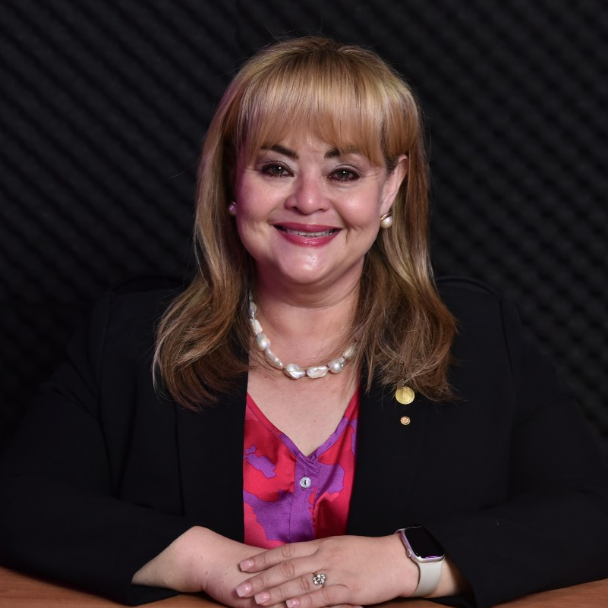
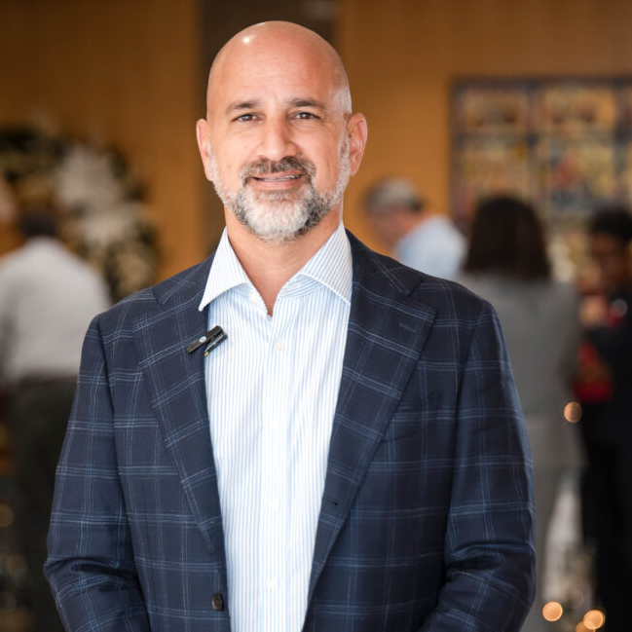
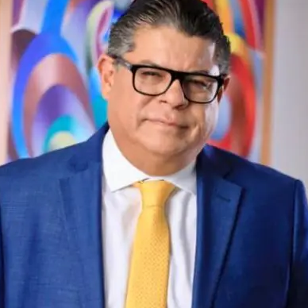
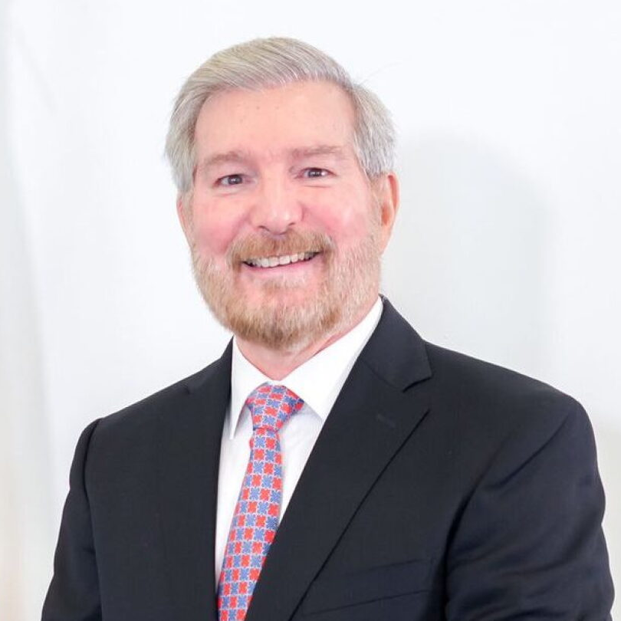
BOARD OF DIRECTORS
Board of Directors
PRESIDENT
Period 2026–2028
Juan Esteban Orrego
Bogotá Chamber of Commerce
REGIONAL VICEPRESIDENTS
NORTH AMERICA
CENTRAL AMERICA
CARIBBEAN
ANDEAN REGION
SOUTHERN CONE
Federico Batlle
Karim Qubain
Lucile Houellemont
Mónica Heller
Paul de Baas
Chamber of Commerce of
Salvadorans in Miami
SALCHAM
Chamber of Commerce and
Industries of Cortés
Chamber of Commerce and
Production of Santo Domingo
Chamber of Commerce
of Quito
Chamber of Commerce and
Industries of Surinam
Cameron McKenzie
Leticia Escobar
Raoul Behr
Eduardo Olivo
Miguel Carrizosa
Chamber of Commerce
of Puerto Rico
Chamber of Commerce and
Industry of El Salvador
CAMARASAL
Chamber of Commerce
of Curaçao
National Chamber of
Commerce of Bolivia
CNC Bolivia
Chamber of Commerce
Paraguayan-Colombian
CAPACOL

Slide 11
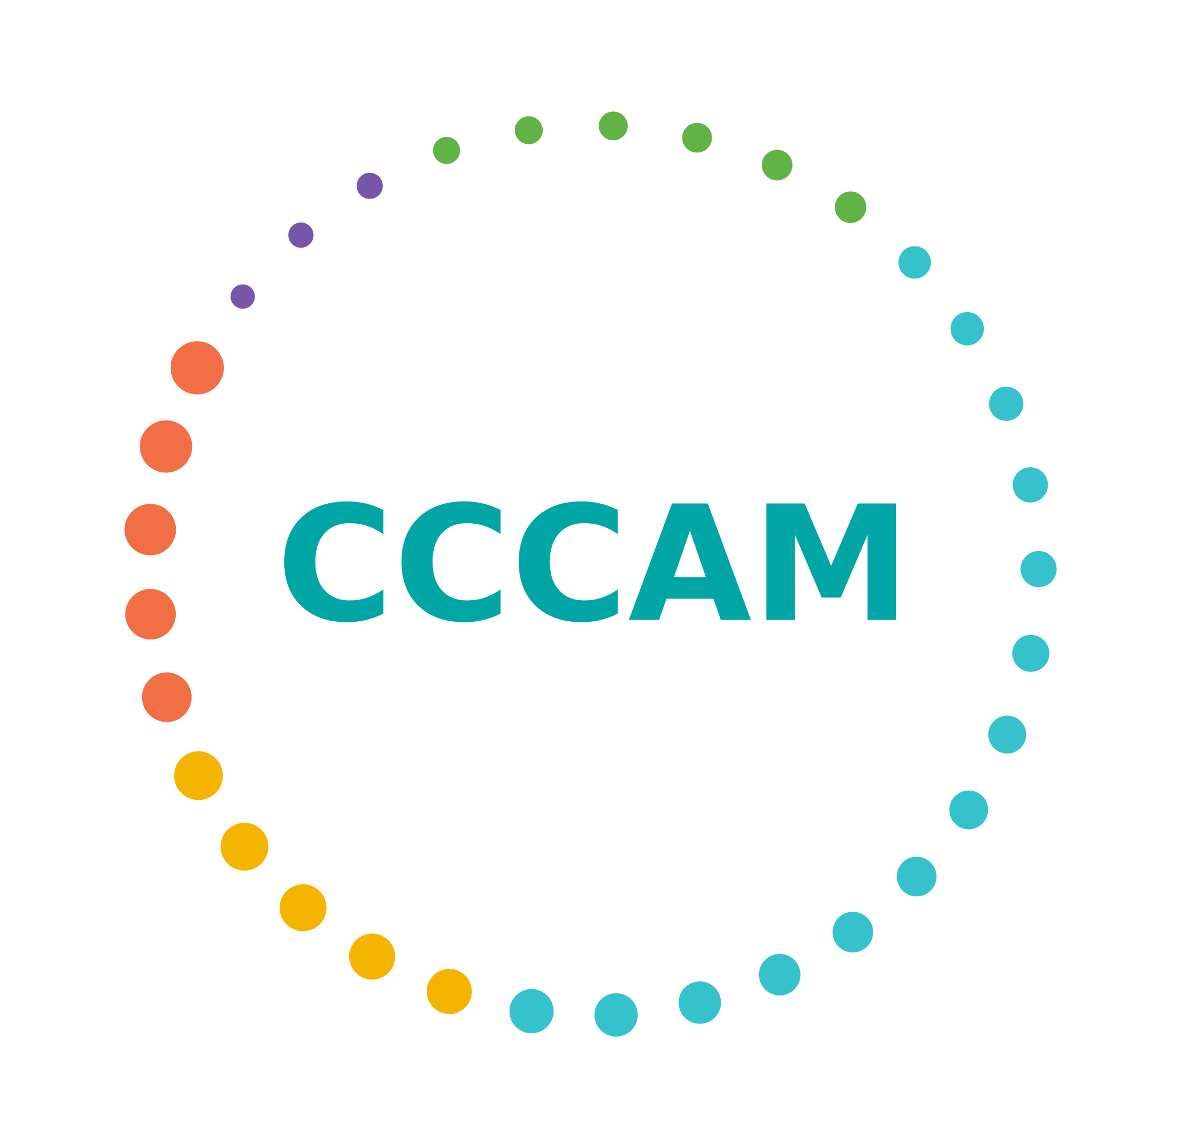
IDENTITY
BRAND IDENTITY
A continental identity for action
The name, symbol, and narrative express integration, movement, equality, and connection among the chambers of the Americas
33-point orbit
Institutional Narrative
Five regions represented in a dynamic, horizontal composition
Diverse capabilities are brought together and turned into knowledge, opportunities, and solutions
Coherent Communication
Clarity, business relevance, results orientation, complementarity, and plurality
CCCAM connects the Chambers of Commerce of the Americas to turn cooperation into results
Notes:
[Sources]
- Propuesta estratégica consolidada del CCCAM, 05 de agosto de 2026.
- Sistema visual heredado de Presentacion_Institucional_CCCAM_2026_2030.pptx.

Slide 12
STRATEGIC PLAN 2026–2030
Purpose, mission, and vision define the 2030 horizon
Purpose
Mobilize the collective capacity and institutional strength of the Chambers of Commerce of the Americas to develop concrete hemispheric solutions that drive competitiveness, integration, investment, and sustainable prosperity for businesses across the continent.
Mission
To connect and strengthen the Chambers of Commerce of the Americas, promote knowledge sharing, help shape international trade rules, and transform regional cooperation into concrete projects, partnerships, and outcomes.
2030 Vision
By 2030, CCCAM will be the leading hemispheric platform for chambers of commerce, a trusted source of business and trade intelligence, and a key private-sector partner for multilateral organizations.
Notes:
[Sources]
- Propuesta Estratégica Consolidada CCCAM 2026–2030, sección 6.1.

Slide 13






STRATEGIC PLAN 2026–2030
Six strategic objectives 2026–2030
Advocacy
Knowledge
Business
Be the hemispheric chamber voice in trade public policy: ≥4 multilateral forums/year with documented influence on ≥10 regulatory decisions.
Become the intellectual authority of American chamber trade: indices and barometers cited by multilateral organizations and specialized media.
Generate concrete business opportunities for companies: measurable business in USD through matchmaking events and business intelligence.
Chamber
Transformation
Institutional
SSustainability
Community
Build the most influential business networking platform in the hemisphere: the Annual Summit and Subregional Forums as leading venues.
Modernize and institutionally strengthen member chambers: digitalization, AI, executive training, and innovation financing.
Ensure long-term financial, legal, and operational viability with a diversified structure and robust corporate governance.

Slide 14
STRATEGIC PLAN 2026–2030
Six Launch Programs 2026–2027
Organized around 5 work streams at CCCAM
WORK STREAM
Trade Promotion and
Business Services
1
Hemispheric Trade Fairs
Connect business supply and demand through in-person, virtual, and hybrid formats, with follow-up on concrete opportunities.
WORK STREAM
Connectivity, Events, and
Positioning
CCCAM Summit
Institutional Trade Missions
2
An annual high-level gathering to build shared positions and strengthen hemispheric positioning.
Agendas and business delegations to strategic markets, supported by the experience of CCCAM members
WORK STREAM
Knowledge and
Trade Intelligence
3
Sector Reports and Business Climate Barometer
Strategic sector information and business-climate monitoring to anticipate trends, opportunities, and risks.
WORK STREAM
International Cooperation
and Partnerships
4
Strategic Multilateral Partnerships
Managing partnerships with multilateral organizations and cooperation agencies to mobilize technical and financial resources.
WORK STREAM
Hemispheric
Policy and Advocacy
5
Regional Value Chains Roundtable
Analyzes nearshoring and productive integration and formulates positions to strengthen regional value chains.

Slide 15
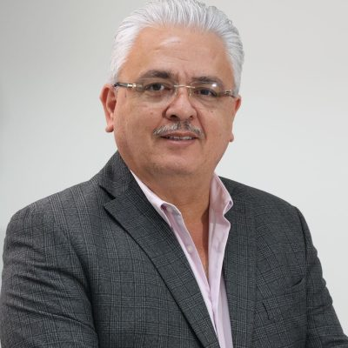
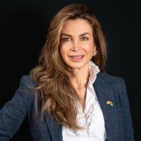

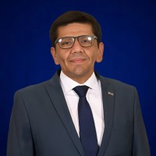
2026–2027 WORK PLAN
Work Streams and Leads
The General Assembly approved the work streams and their leads, and proposed a new Women’s Empowerment work stream.
Trade Promotion
and Business Services
Connectivity, Events
and Positioning
Knowledge and
Trade Intelligence
International Cooperation
and Partnerships
Hemispheric Policy
and Advocacy
Women’s
Empowerment
PHOTO
PHOTO
PHOTO
PHOTO
PHOTO
PHOTO
Francisco Serracín
Sonia Cortés
Mónica Heller
Jan Wilhen
Van Bokhoven
Boris Gómez
Leticia Escobar
Chamber of Commerce,
Industry and Agriculture
of Chiriquí
Chamber of Commerce
Colombo-Canadian
Chamber of Commerce
de Quito
Colombian-Dutch Chamber
Holland House
Chamber of Commerce
Chilean-Bolivian
CHILEBOL A.G.
Cámara de Comercio e
Industry of El Salvador
CAMARASAL
PROPOSED WORK STREAM

Slide 16
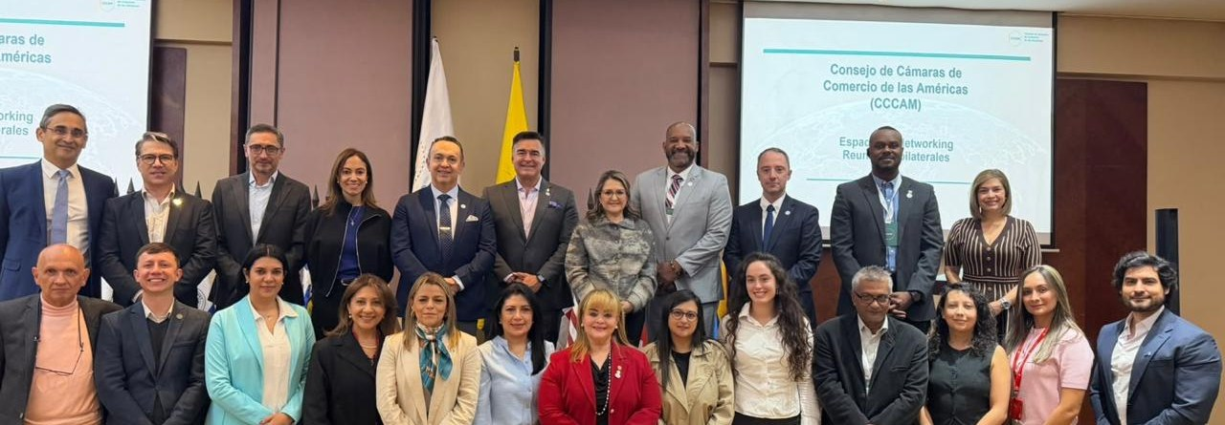
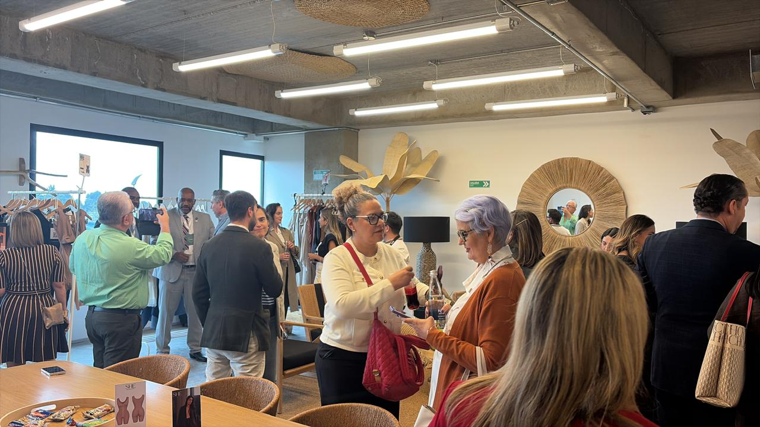
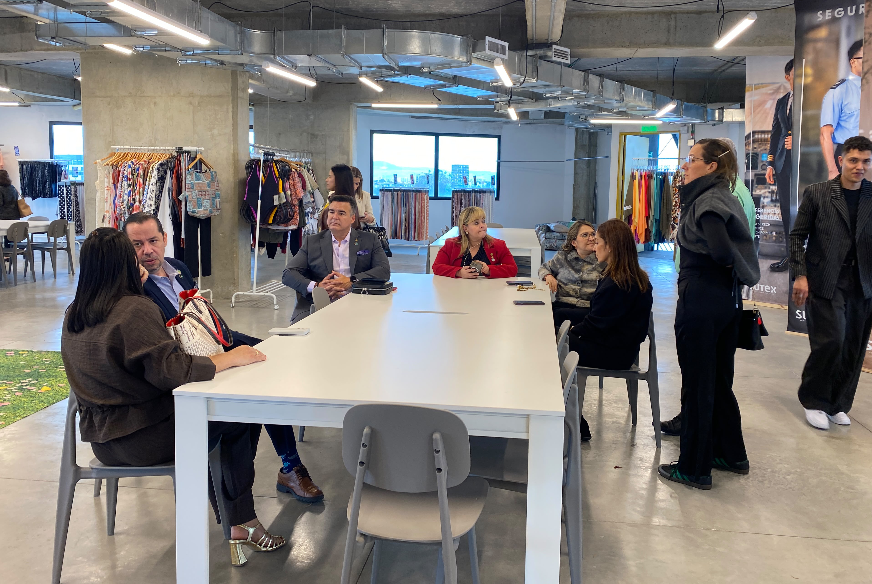
SEPTEMBER 24, 2026
The network began operating from day one
After installing governance, the chambers activated tools for their companies and new market opportunities.
Institutional breakfast: hemispheric opportunities
Visit to the Tejido Fashion Mart Foundation
ICC · One Click and TradeRoots Americas
AI to support exporting MSMEs through to real operations.
The delegations toured the space led by Sutex, explored its showrooms, and engaged with buyers on how brands can permanently display and market their products.
Alpheus IQ
Financial training and preparation to access capital.
Outcome: a line of collaboration was opened for CCCAM to have a showroom to promote member companies and products.
UNIDO
Digital transformation and AI for industry and MSMEs.
These spaces gave immediate continuity to the mandate: turning chamber cooperation into concrete action.

Slide 17






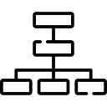

ROADMAP
Three phases turn the mandate into capacity, scale, and impact
Phase III – Consolidation and impact
2029 - 2030
Phase II – Hemispheric rollout
2027 - 2028
Phase I – Establishment and launch 2026 – Q1 2027
Formalization and installation of governance bodies.
Executive capacity, budget, and first programs.
New member chambers.
Knowledge and connection platforms.
Operational partnerships and stable programs.
Continental positioning.
Diversified sustainability.
Impact evaluation and 2031–2035 Plan.
Notes:
[Sources]
- Propuesta estratégica consolidada del CCCAM, 05 de agosto de 2026.
- Sistema visual heredado de Presentacion_Institucional_CCCAM_2026_2030.pptx.

Slide 18


















COUNTRIES OF THE CONTINENT
Founding Countries
Southern Cone
18
Paraguay
Surinam
Chile
Brazil
North America
Founding
Countries
United States
Canada
Puerto Rico
Central America
El Salvador
Honduras
Panama
Caribbean
across the 5 regions of the hemisphere
Aruba
Curaçao
Dominican Republic
Andean Region
Bolivia
Colombia
Ecuador
Peru
Venezuela

Slide 19



















FOUNDING MEMBERS
36 Founding Chambers of Commerce

Slide 20

















FOUNDING MEMBERS
36 Founding Chambers of Commerce

Slide 21
FINANCIAL SUSTAINABILITY
2027 Membership with Early-Joining Benefit
Fees exclusive to member chambers
General Considerations
Affiliates per Chamber | Annual Fee (USD)
Over 4,001 | 9000
2,001 - 4,000 | 6000
1,001 – 2,000 | 3000
Under 1,000 | 1500
• Annual payment due by March 31.
• First installment corresponds to the 2027 period.
• The fee does not affect voting rights: one chamber, one vote.
• Join 36 founding chambers from 18 countries.

Slide 22
FINANCIAL SUSTAINABILITY
2027 Membership with Early-Joining Benefit
Chambers that join in 2026 receive a discount on their first annual fee.
10 %
Affiliates per Chamber | Annual Fee (USD) | With 10% discount (USD)
Over 4,001 | 9000 | 8100
2,001 - 4,000 | 6000 | 5400
1,001 – 2,000 | 3000 | 2700
Under 1,000 | 1500 | 1350
discount for chambers that formalize their membership
before December 31, 2026
General Considerations
• Annual payment due by March 31.
• First installment corresponds to the 2027 period.
• The fee does not affect voting rights: one chamber, one vote.
• Join 36 founding chambers from 18 countries.

Slide 23
MEMBERSHIP
How to Join CCCAM
A clear institutional process protects the quality of the network and enables orderly integration.
REQUIREMENTS
Be a chamber of commerce or equivalent chamber entity, legally established.
ADMISSION PROCESS
1
Application
Written submission with documentation evidencing the requirements.
Have at least two years of active operation.
2
Technical review
Verification by the Executive Directorate within a maximum of 30 business days.
Have a representative business base and democratic governing bodies.
3
Decision
The Board of Directors approves membership by simple majority.
Not be subject to direct control by governments, political parties, or religious entities.
4
Integration
The chamber joins the network according to its category, and the General Assembly is informed.
Accept the Statutes, Code of Ethics, regulations, and financial obligations.
Join CCCAM

Slide 24
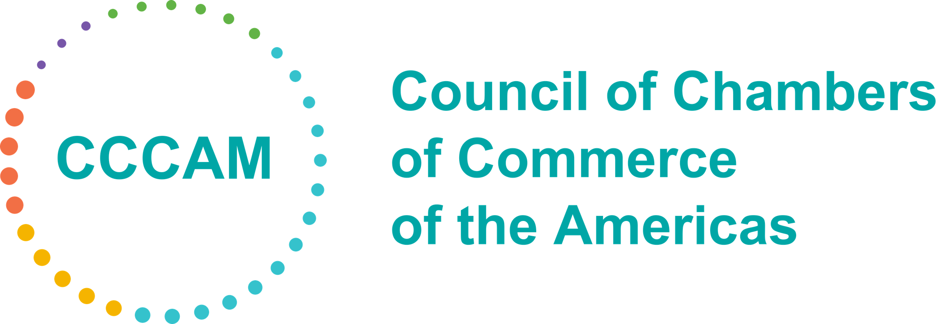
Thanks!

